Slide 1
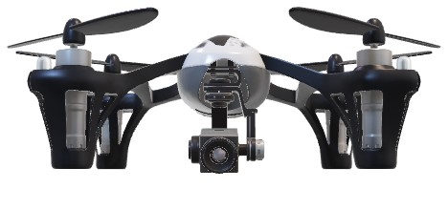
Milestone I Presentation
FPGA for Machine Learning on a Drone

Slide 2
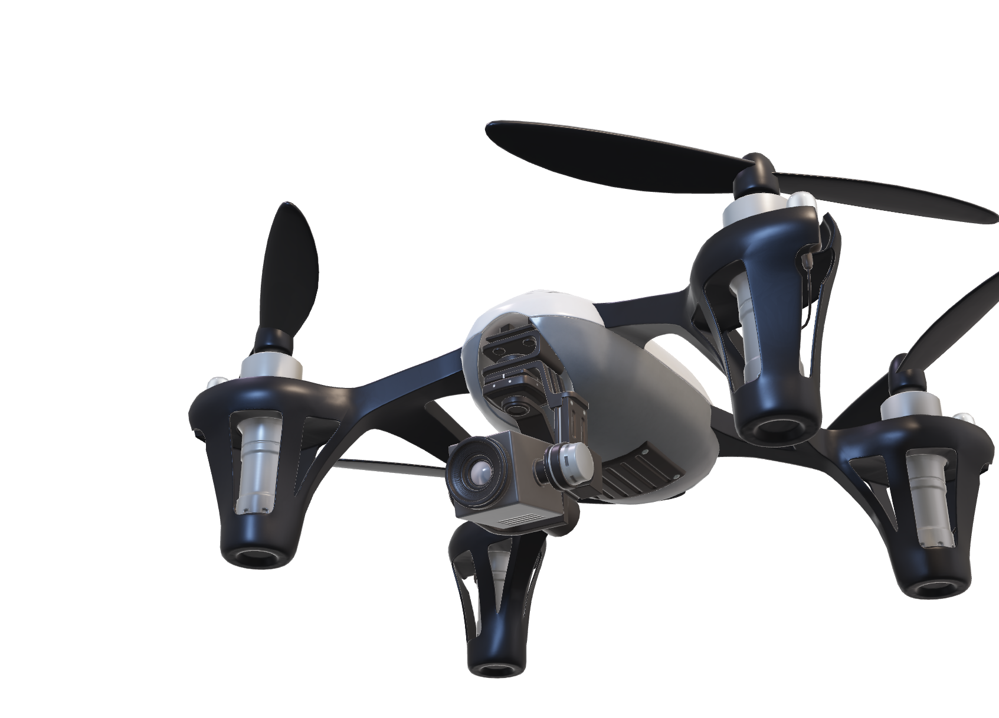
Presentation Overview
Context and Purpose
Requirements
Constraints
Risks
Risk Mitigation
Viability of the Project
Solution Path

Slide 3
Why?

Slide 4
Context & Purpose

Slide 5
What?

Slide 6
Requirements

Slide 7
Constraints

Slide 8
Risks?

Slide 9





Risks
Hardware
Management
Legacy
Software
Flight crashes
Loss of FPGA
Loss of drone
Not enough commitment from teammates
Poor decision making
Low repairability / maintainability
Client doesn’t know how to operate
Blah

Slide 10
Risks

Slide 11
Risks Management

Slide 12
Viability

Slide 13
How?

Slide 14
Solution Path

Slide 15
Q?

Slide 16
Q?
-- zoom summary here --

